Slide 1
Chapter 1. Fundamental Elements

Slide 2
Contents
Introduction – Fundamental Concepts
Introduction – Linear Electronic Devices
Aim of this Course
To provide a sound understanding of basic devices and circuits in Electronic Engineering.

Slide 3
1.1 Introduction– Fundamental Concepts
Now we will review some basic concepts
Charge
Electrostatic Potential & Voltage
Current & Resistance
Ohm’s Law
Power & Energy

Slide 4
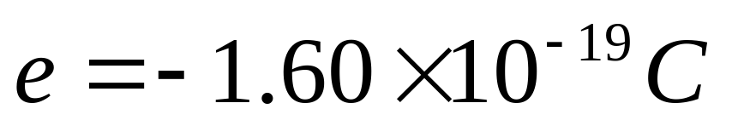
Charge
Experimentally determined to be of two types;
The distinction is designated + and – ;
The unit of charge is a quantum unit, +e or –e ;
A proton (质子) is designated to have charge +e;
An electron is designated to have charge –e;
1 Coulomb of charge has about 6.242×10¹⁸ e;

Slide 5
Inside a conductor
Some e_{s} in conductors are not bound to particular atom but are free to move from atom to atom.
These conduction e_{s} may be imagined as gas particles in a box.
In a metal the conduction e_{s} move against a crystal lattice background of atomic sites.
Their “collision” with each other and the lattice is the source of resistance (to be described)

Slide 6
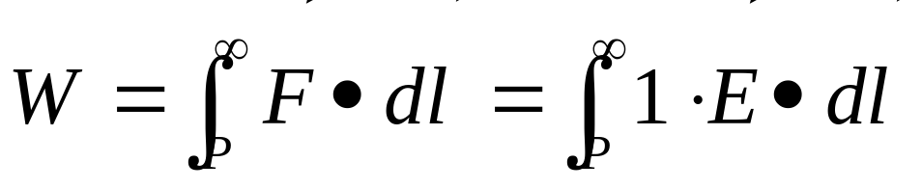
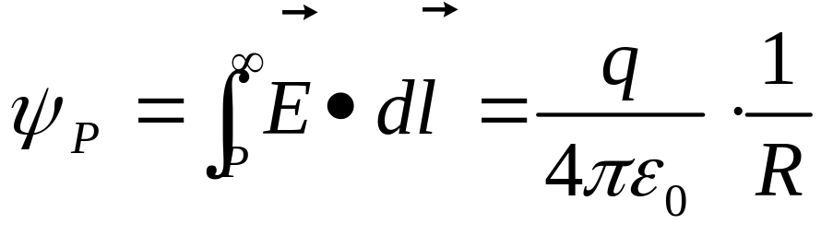







The electrostatic potential
External work must be applied to move a charge against the force of an electrostatic field that it experiences.
Electrostatic potential is exactly the external work exerted on a unit charge when it is removed from the observation spot to infinity.
P

Slide 7
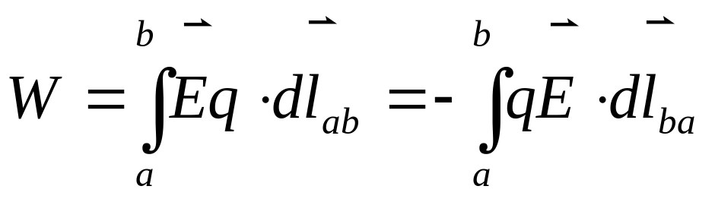

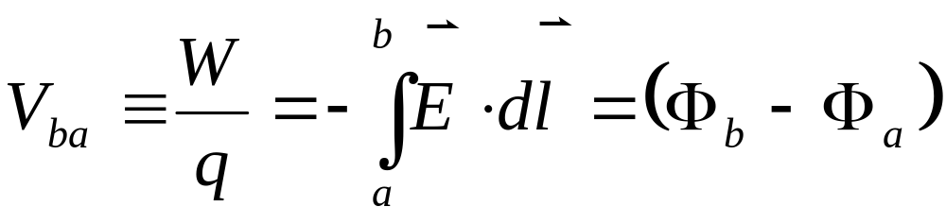
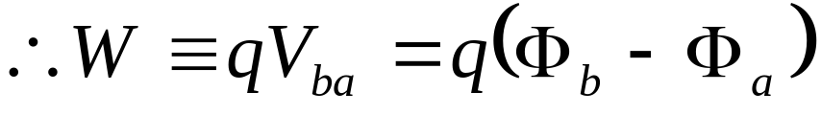
Voltage is proportional to potential energy difference between two points
+
b
q
a
-
Volts

Slide 8

Current & Current Intensity
Current: I (A: Ampare)
  How many charges flow across the conductor within 1s?
Current Intensity: (A/m²)
  How many charges flow across per square x-section the conductor within 1s?

Slide 9
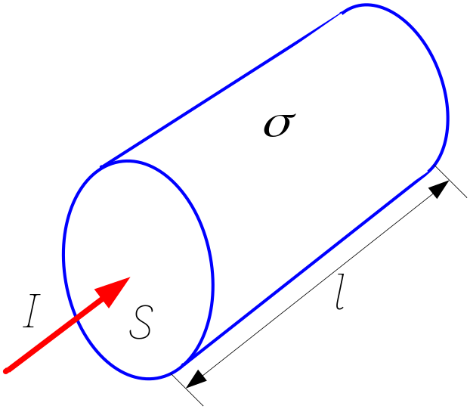
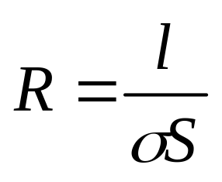

Ohm’s Law
R=U/I
A macroscopical view

Slide 10
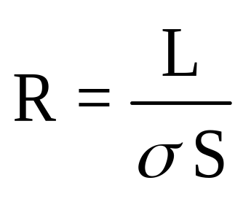
Resistance is proportional to length and inversely proportional to the cross sectional area
L
A
σ
Long wires have large resistance
Thick cross section bars
will have low resistance
Resistance depends on the material

Slide 11
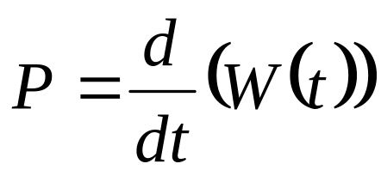
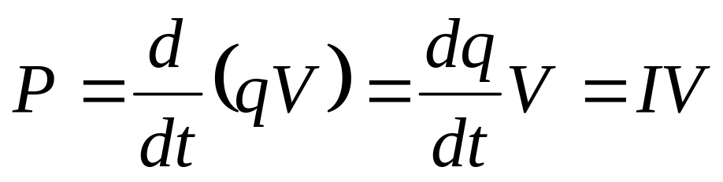
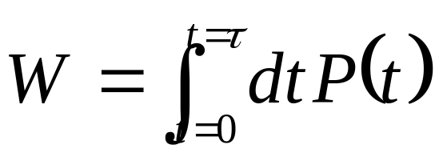
Power & Energy
By definition power is the rate at which work is done, either by a system, or to a system.
The power delivered to a circuit by a source of e.m.f is
Inversely, the energy delivered is the time integral of the power applied

Slide 12
Examples of voltage sources
DC
Pulsed
voltage
time
AC
Ramp

Slide 13
For an ideal voltage source, voltage is independent of current.
I
v(t)
+
_
V
Reference current convention of a voltage source is arbitrary

Slide 14
In an ideal current source, current is independent of voltage.
I
i(t)
V

Slide 15
About Dependent Source
It provides a current or voltage whose value is dependent on the current or voltage elsewhere.
It is controlled by the parameters of the other elements.
It is give a diamond symbol with a controlling signal, such as
+
I_{s}=Ai_{y}
V_{s}=0.4i_{x}
-

Slide 16
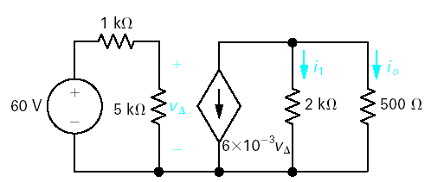
Example 1

Slide 17
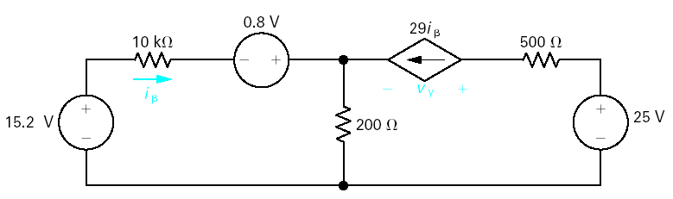
Example 2

Slide 18
1.2 Introduction – Linear Electronic Devices
Resistors
Capacitors
Inductors

Slide 19
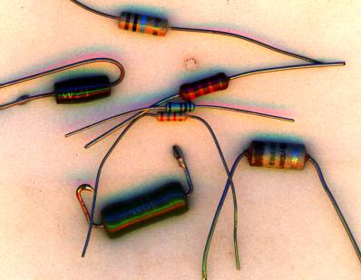
Resistors
Resistors are commonly available in a range from 1 Ω to 10MΩ and power ratings from 1/8 Watt to several Watts
Modern resistors consist of a metal oxide deposited on a ceramic rod. The oxide may have a spiral groove cut in it to increase its resistance
Early resistors consisted of a carbon composition in an insulating tube
Some high power resistors use Nichrome (stainless steel) wire wound round a ceramic core and covered with vitreous enamel (glass)
Notes:
Ceramic [si’rAmik] adj. 陶器的
Nichrome [`naIkrEJm] n.[亦作n-][冶]镍铬合金,镍克罗
Vitreous [5vitriEs] adj. 玻璃质的
Enamel [i5nAmEl] n. 珐琅, 瓷釉, 指甲油

Slide 20
Resistors are not perfect: ☹
  They are not totally independent of temperature, perhaps increasing by a few % at -50 C and +150 C.
  They will have some capacitance between the two ends.
    Then will they have some inductance?
    Then how and where?
  They will have some inductance, particularly the wire wound versions.
  However these effects are negligible in nearly all cases and resistors can be regarded as “perfect” for most purposes.

Slide 21
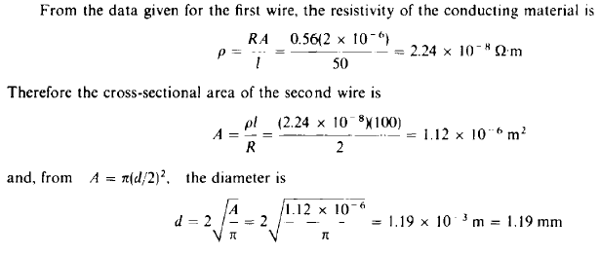
Exercise
A wire 50m in length and 2mm² in cross section has a resistance of 0.56 Ω.. A 100m length of wire of the same material has a resistance of 2 Ω at the same temperature.
Find the diameter of this wire.

Slide 22
Capacitors
A capacitor consists of two conductors separated by an insulator.
Generally 3 types
Made of paper
Danger
High Voltage
1μF
Electrolytic capacitor
10 μF
100kV
Ceramic capacitor
440pF

Slide 23
For all typical capacitors
C=Q/V
The unit of capacitance is farad (F).
The capacitance depends on its size and material, independent of whether it is charged or not.

Slide 24
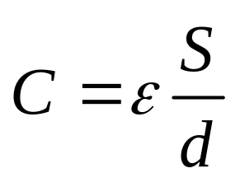
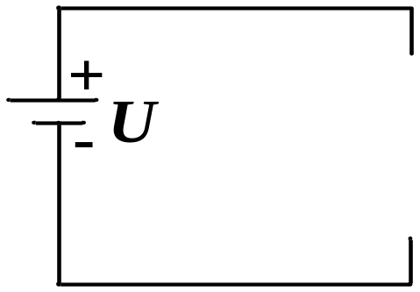
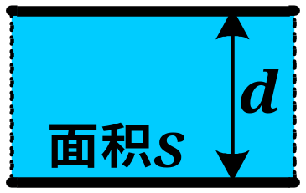
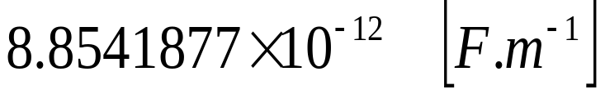
Capacitance can be readily calculated for geometric figures with constant cross-section.
S
d
ε
ε is the dielectric constant, ε = ε_{r}ε_{ο}
ε_{r} = relative dielectric constant
ε_{o} =
Notes:
Farad [5fArEd] n. [电]法拉(电容单位)

Slide 25
A capacitor consists of two conductors separated by an insulator.
To construct a large capacitance, the difficulties are:
  Getting the area of the conductors, S, as large as possible in a confined space.
  Getting the insulator thickness, d, as thin as possible. If too thin it will break down under the voltage applied.

Slide 26
Capacitor Values
Capacitors are available from a few pF (10⁻¹²) up to 1000s of µF (rarely called milliFarads ).
Capacitors need to be specified for their voltage capability. They may also be restricted in their current carrying capacity.
Capacitors rarely look like perfect capacitance.
  They have losses in the insulator which looks like series resistance and leakage (electrolytics) which looks like parallel resistance.
  The wound capacitors also have significant inductance!

Slide 27
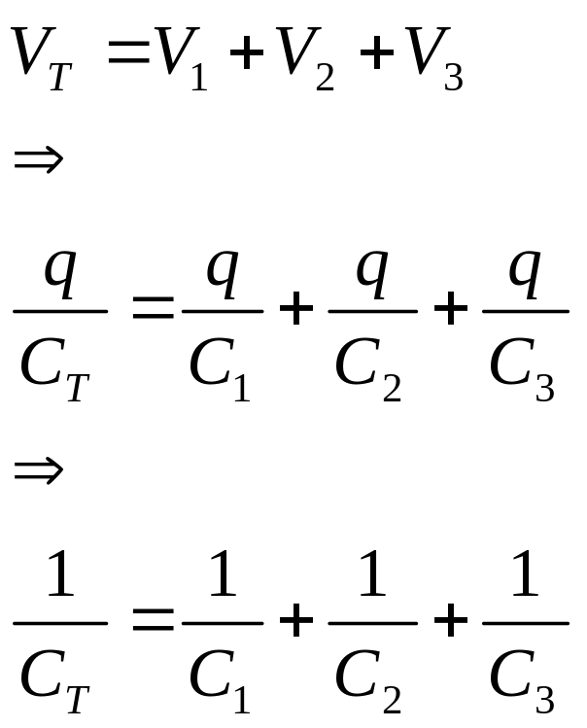
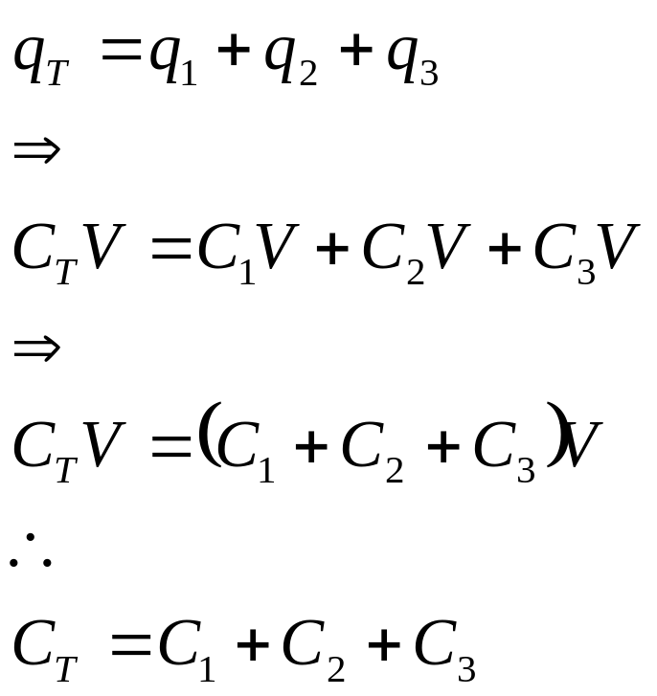
Effective (or net) capacitance of parallel (a) & series (b) capacitor combinations
(a)
V
C₁
C₂
C₃
(b)
C₁
V
C₂
C₃

Slide 28
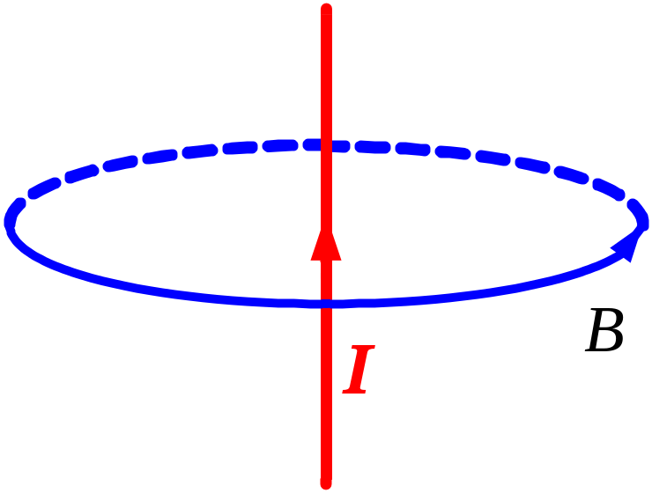
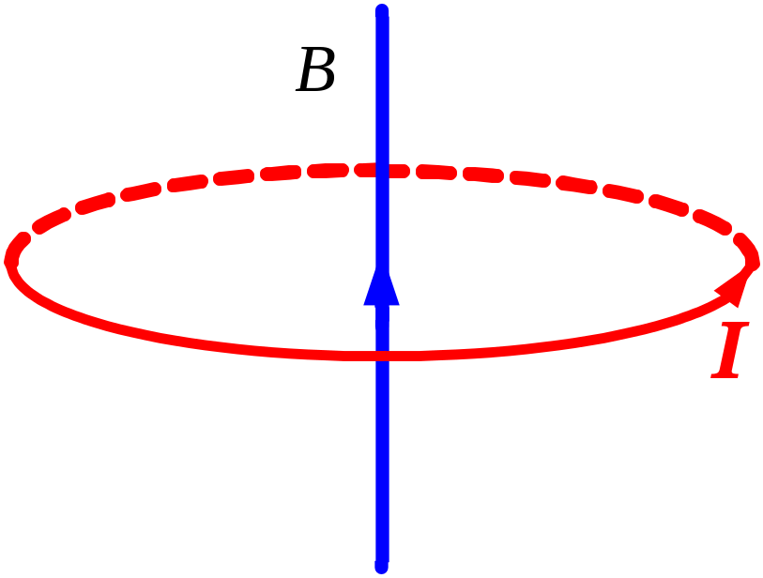
Inductors
Direction of the current and the inductive magnetic field.
Use your right hand.

Slide 29
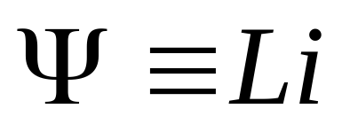
Flux linkage also equals current times inductance.
i(t)
+
L
Flux
Linkage
v(t)
_
Inductance
Unit of inductance is Henry

Slide 30
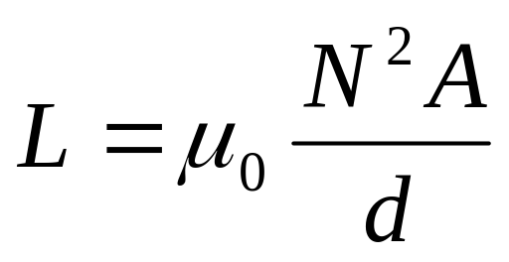
Inductance can be readily calculated for a long solenoid.
A
d
Permeability磁导通率
No magnetic core
Notes:
Solenoid [5sEulinCid] n.【电】螺线管, 螺线管线圈, 电磁线圈

Slide 31
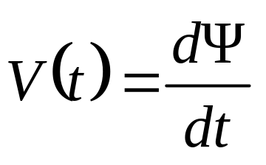
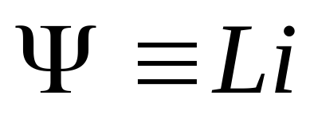
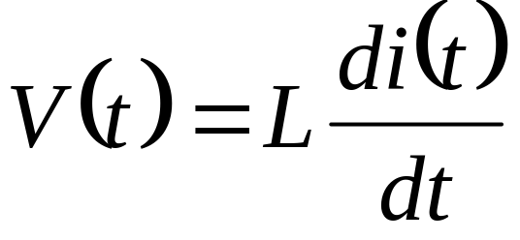
In an inductor, voltage is proportional to the derivative of current
i(t)
+
v(t)
L
_
Note reference directions

Slide 32
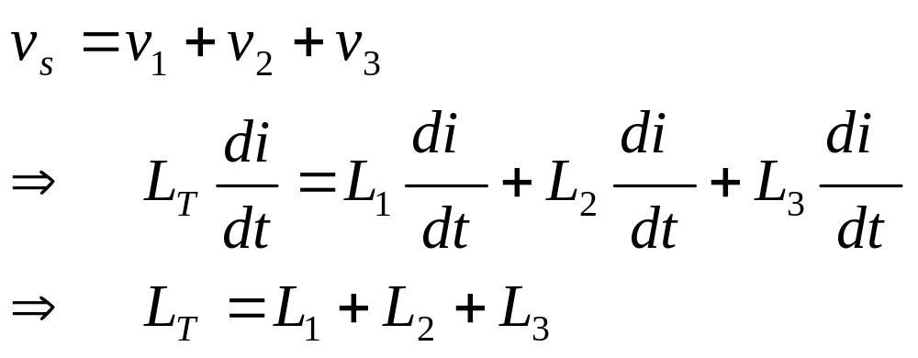
Net Inductance of Series Inductors
+
v₁
L₁
−
+
v_{s}
+
v₂
L₂
−
−
+
v₃
L₃
i
−

Slide 33
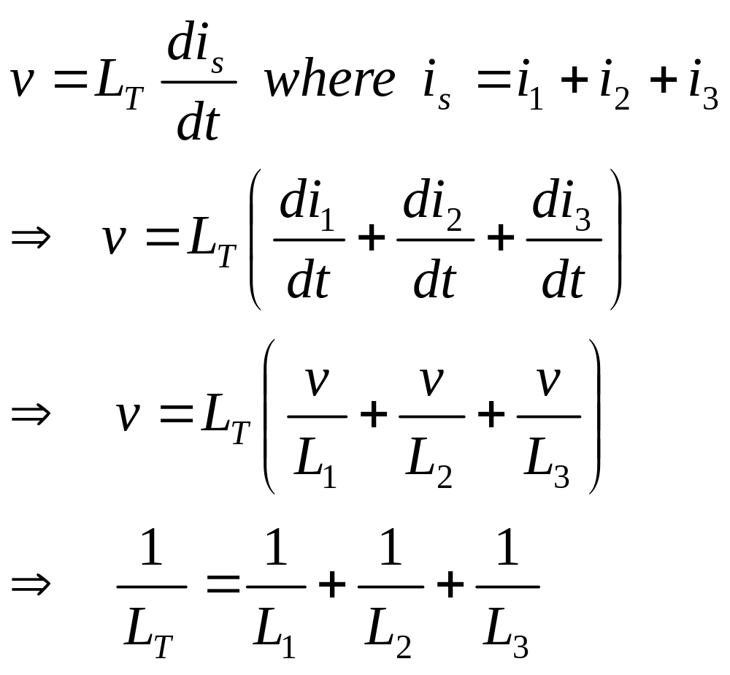
Net Inductance of Parallel Inductors
+
i_{s}
v
L₁
L₂
L₃
-

Slide 34
Summary of terminal relations for passive elements
dq
Resistor
v
=
R
dt
Capacitor
dv
i
=
C
Memorize!!
dt
Inductor
d
i
v
=
L
dt

